Slide 1
Web Programming Project - 02
Priyanka Ghare, Gowtham Thatavarthi

Slide 2

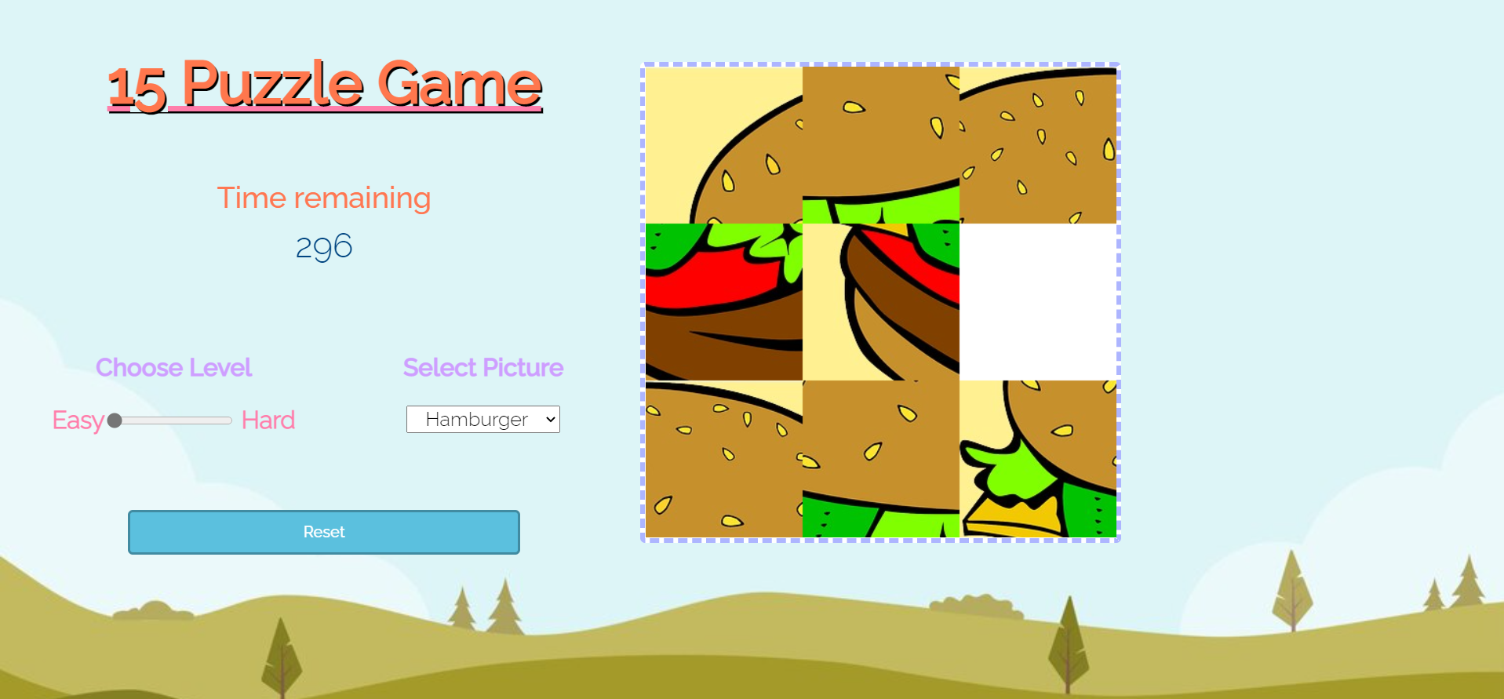
Fifteen Puzzle Game
Fifteen puzzle is a game where we unjumble its fifteen squares by repeatedly making moves that slide squares into the empty space. The user interface has a puzzled image with 15 tiles displayed and one square empty. The user selects on each tile on screen and move it to desired position and hence the user has to solve the puzzle to create the original image

Slide 3
Development Strategy - Scrum
We used scrum methodology to development, testing and communication in the team
We divided the tasks into Design, Develop and Testing and the team lead assigned to these tasks
We conducted weekly standups to discuss the progress of tasks and help each other in the team
We created discord channel to communicate within the team

Slide 4
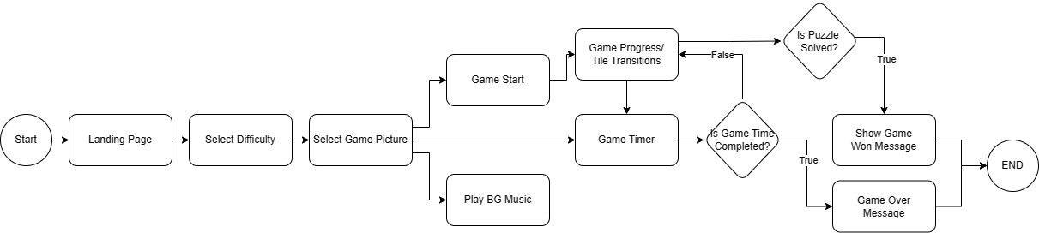
UML Flow of Fifteen Game

Slide 5
Features Implemented
Additional Features Implemented
End of game notification
Animations and transitions
Game time with background music
Multiple Background
Different Puzzle Size Option
Reset Button to start puzzle again

Slide 6
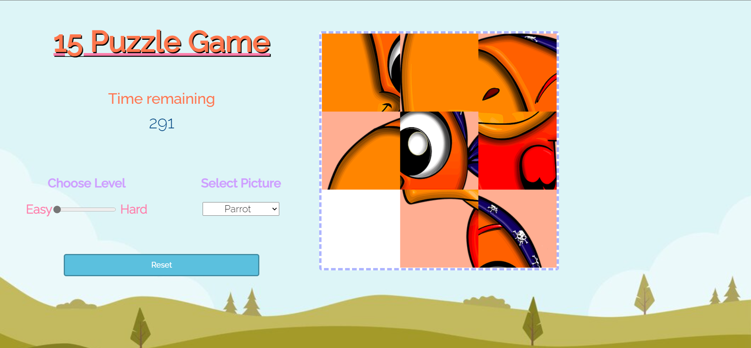
Main Game Page

Slide 7
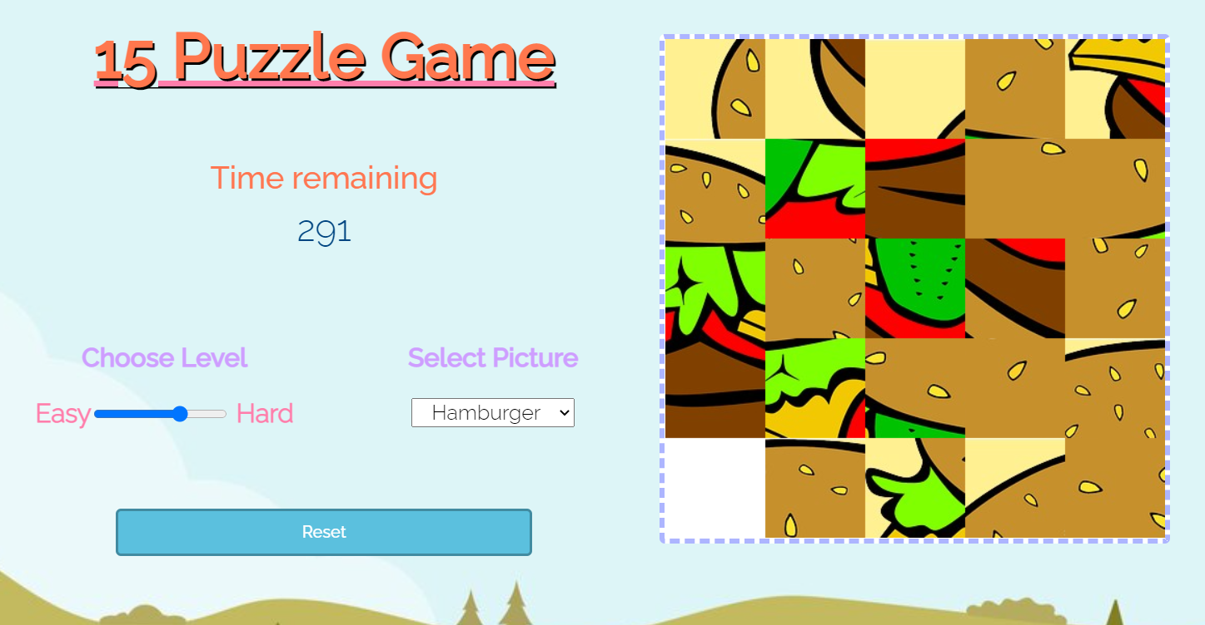
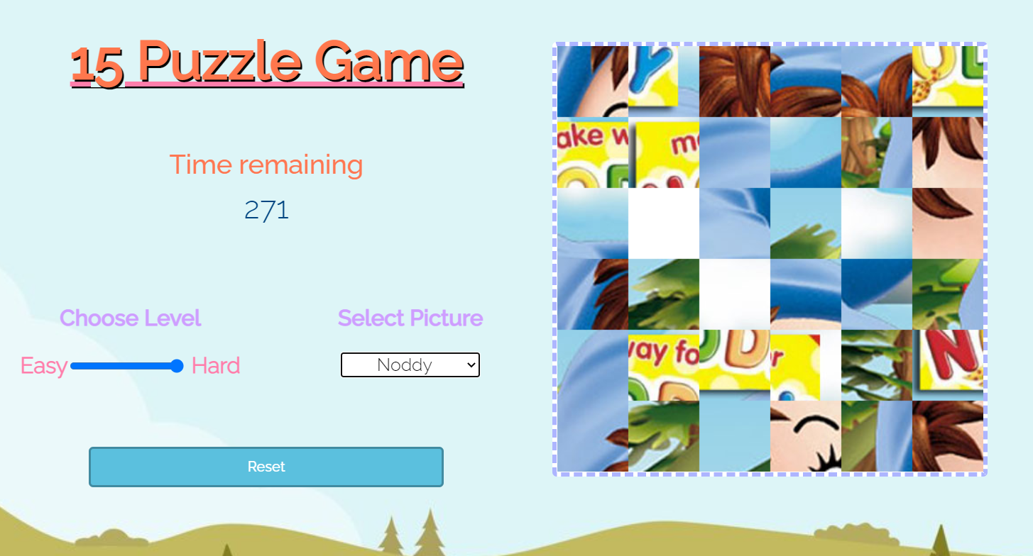
Combinations Implemented -
3X3
4X4
5X5
6X6

Slide 8
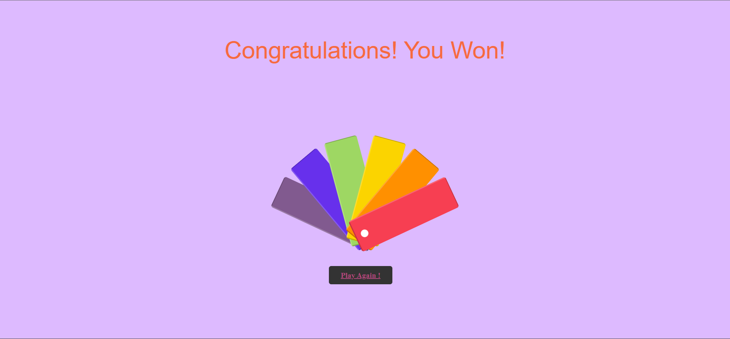
Game Winning Page

Slide 9
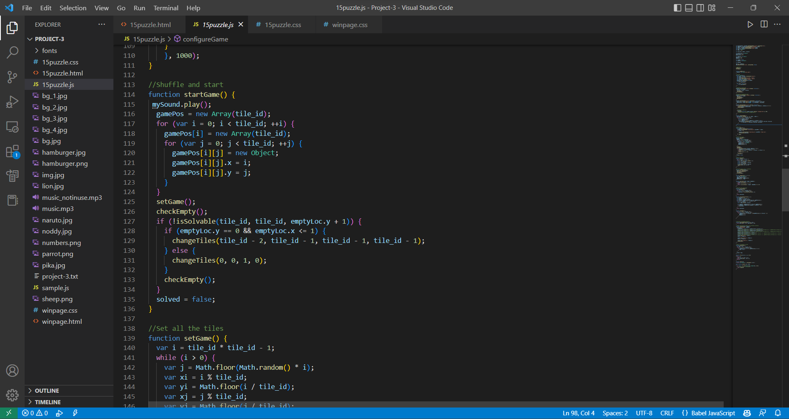
Shuffle Algorithm Code

Slide 10
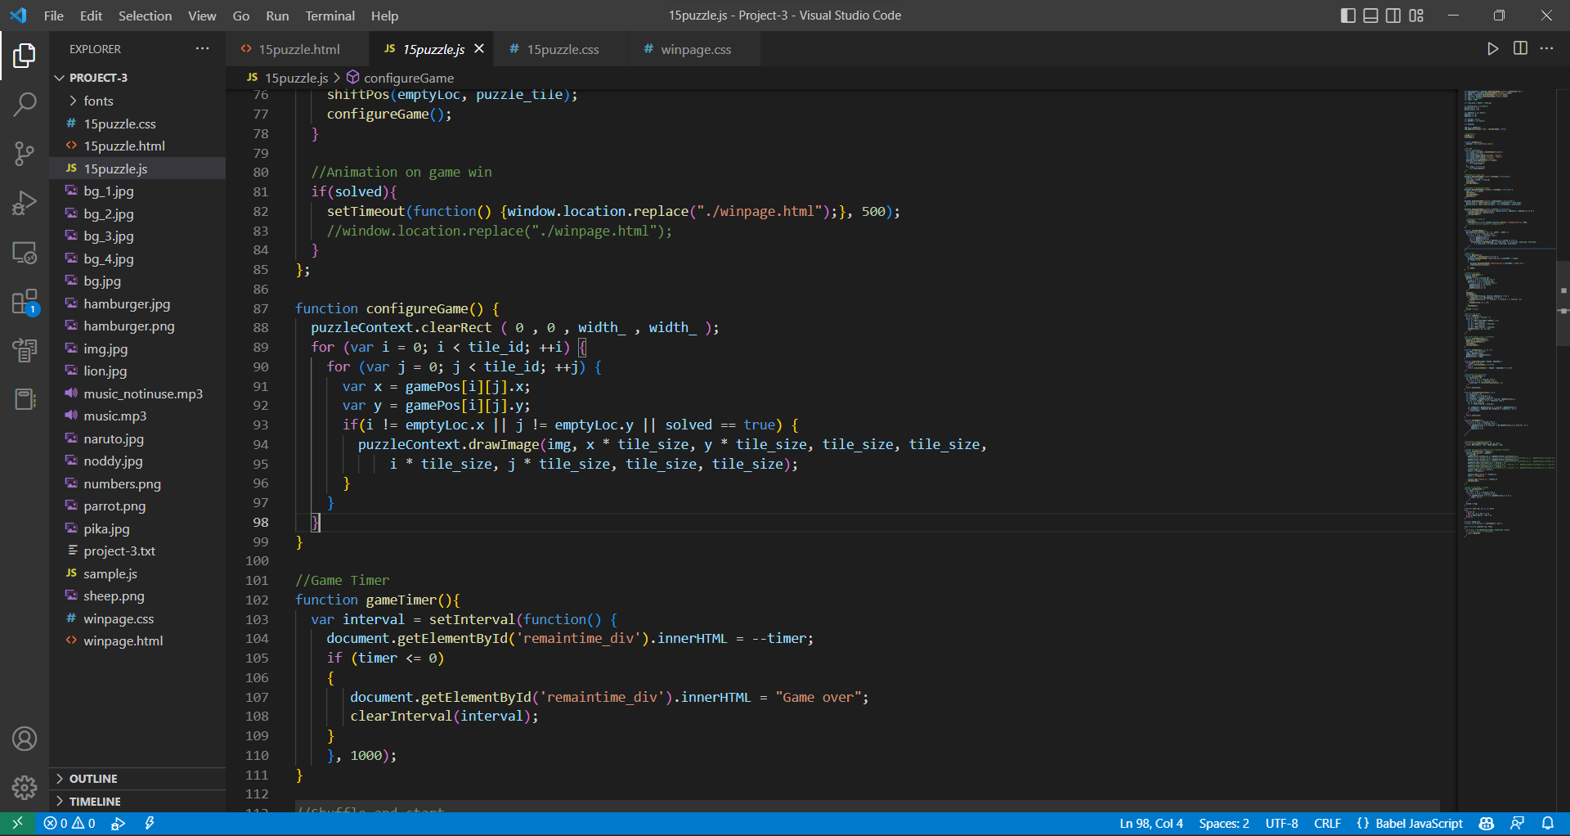
Game Configuration Code

Slide 11
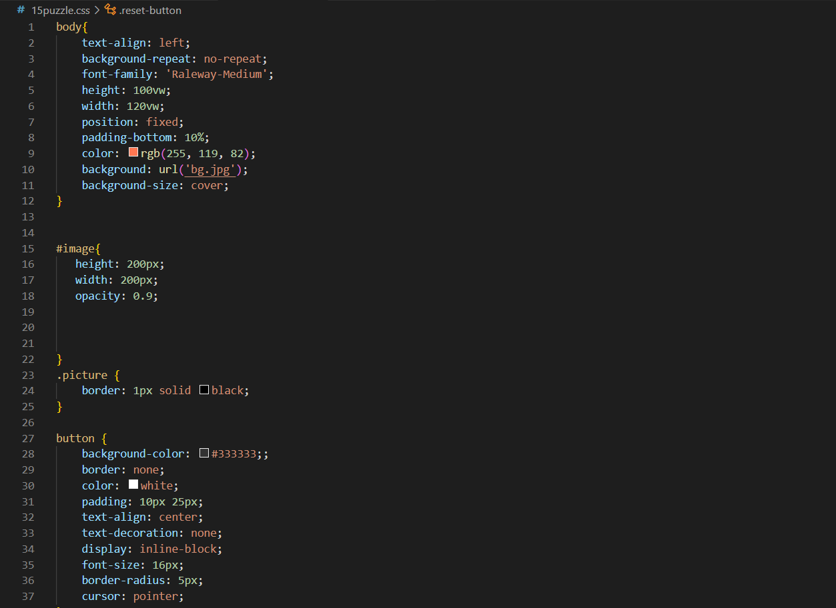
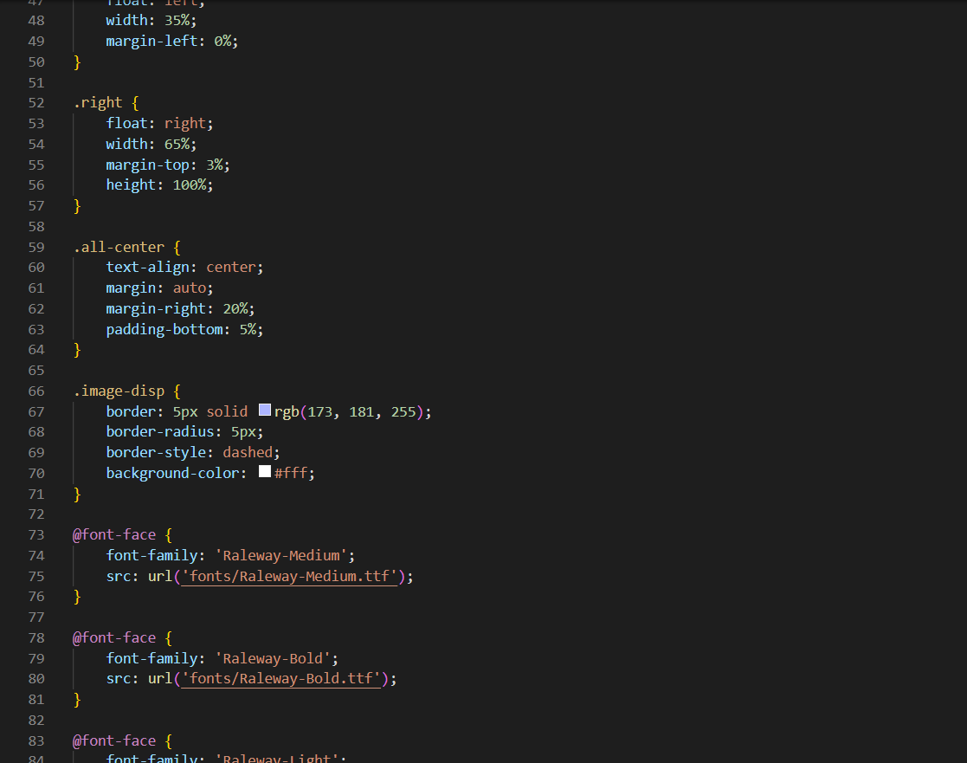
Webpage Style Sheet - CSS

Slide 12
Performed Testing On Website
Test Plan - Strategy
Validated pages styling with CSS validator.
Checked on multiple browsers like Microsoft Edge, Chrome, and Mozilla Firefox.
​Divided the use case into small independent features and functions
Developed them and tested them using unit test methodology
On all the small unit tests are successful, we integrated and tested the final project.

Slide 13
THANK YOU
Priyanka Mahendra Ghare
pghare1@student.gsu.edu
Gowtham Thatavarthi
nthatavarthi1@student.gsu.edu

